Slide 1

Objective Detection Cheat Sheet
By: Jesus Gudino
03/21/2025
ITAI 1378
Professor: Anna Devarakonda

Slide 2
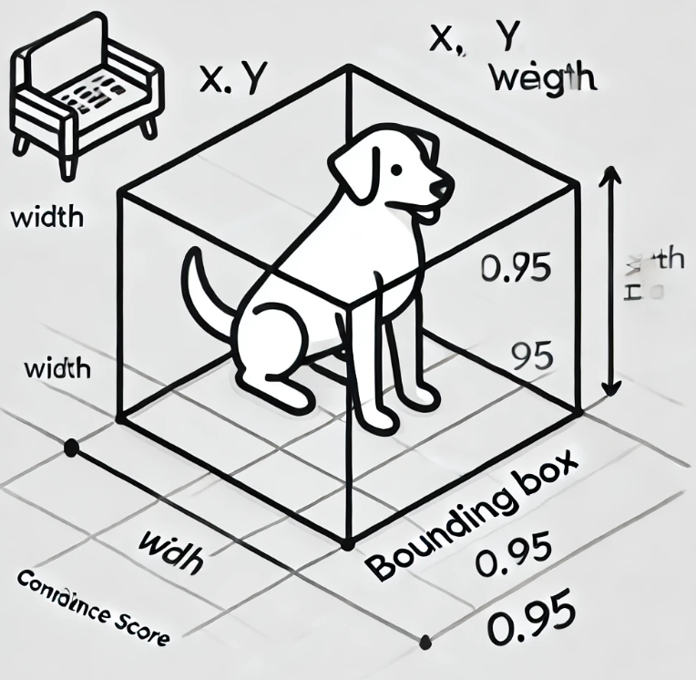
Key Concepts
Bounding Boxes - Rectangles used to detect objects
Annotations - Labeled regions in images
Confidence Score – Probability that detected object is correct
IoU (Intersection over Union) – Measures accuracy of detection

Slide 3
Algorithms Overview
Algorithm | Description
R-CNN | Region-based CNN, slower but accurate
Fast R-CNN | Optimized R-CNN, speeds up training
Faster R-CNN | Adds Region Proposal Networks (RPN) for real-time processing
SSD (Single Shot MultiBox Detector) | Fast, good for real-time use
YOLO (You Only Look Once) | Fastest, widely used in real-time detection

Slide 4

Steps in Object Detection
1. Data Collection
Gather labeled images using datasets like COCO or Pascal VOC.
2. Data Preprocessing
Resize, normalize, and augment images.
3. Model Selection
Choose an algorithm like YOLO, SSD, or Faster R-CNN.
4. Model Training
Train the model to recognize features, classes, and bounding boxes.
5. Evaluation
Use IoU, mAP, and Precision/Recall to measure performance.
6. Deployment
Integrate the model into a real-world application.

Slide 5
Tools & Libraries
Books:
- "Deep Learning for Computer Vision" – Adrian Rosebrock
- "Hands-On Machine Learning with Scikit-Learn, Keras, and TensorFlow" – Aurélien Géron
Online Tutorials & Courses:
- TensorFlow Object Detection API: tensorflow.org/lite/models/object_detection
- PyImageSearch: pyimagesearch.com
- OpenCV Docs: docs.opencv.org
Noteworthy Pre-trained Models:
- YOLOv8 – Ultralytics GitHub: github.com/ultralytics/yolov5
- Faster R-CNN – TensorFlow Model Zoo
YouTube Channels:
- Henry AI Labs
- Computerphile

Slide 6
Challenges & Troubleshooting
Creating this object detection cheat sheet helped me better understand how various models and tools work together to identify and localize objects in images. I learned about key components such as bounding boxes, Intersection over Union (IoU), and confidence scores, and how they are used to evaluate a model’s performance.
I also discovered the differences between one-stage detectors like YOLO and SSD, and two-stage detectors like Faster R-CNN. Exploring tools like TensorFlow, Keras, and OpenCV gave me insight into how these models are implemented in practice.
This cheat sheet will be a valuable reference for future projects in computer vision, especially when building or training object detection models. It simplifies complex ideas into digestible sections, which is helpful when working under time constraints. Overall, this assignment deepened my understanding of object detection and improved my ability to communicate technical information clearly.

